Slide 1
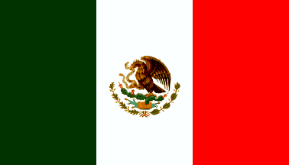
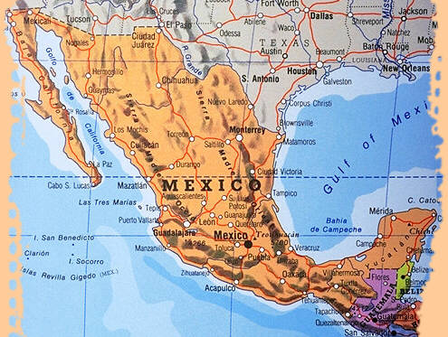
Mexico
Click on the link (PBS Kids)
to learn about
Cinco de mayo!
https://safeYouTube.net/w/ras9

Slide 2
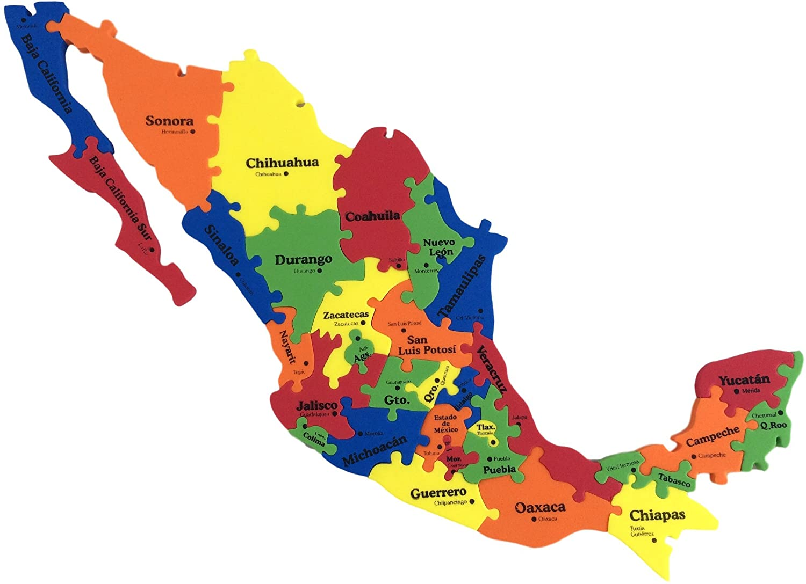
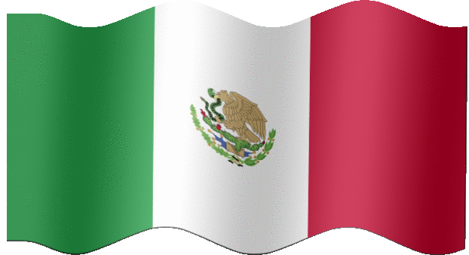
Location
Mexico is a country located on the continent of América del Norte (North America).

Slide 3
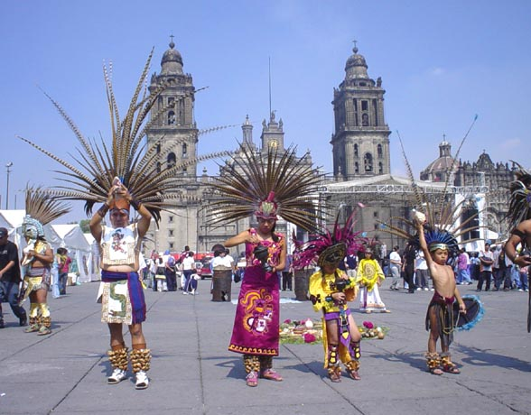
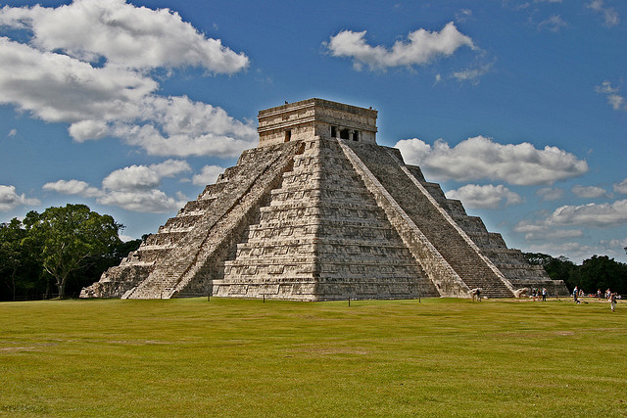
Famous Landmarks
Zócalo, Mexico City –Zócalo- A public plaza. pronounced: thoh-kah-loh.
Chichen Itza- Temple-pyramid of El Castillo (The Castle). https://safeYouTube.net/w/sbs9

Slide 4
Language
The official language of Mexico is Español.
Did you know that español isn’t the only language spoken in Mexico?! Click on the links below to hear some examples of native Mexican languages like náhuatl and maya.

Slide 5
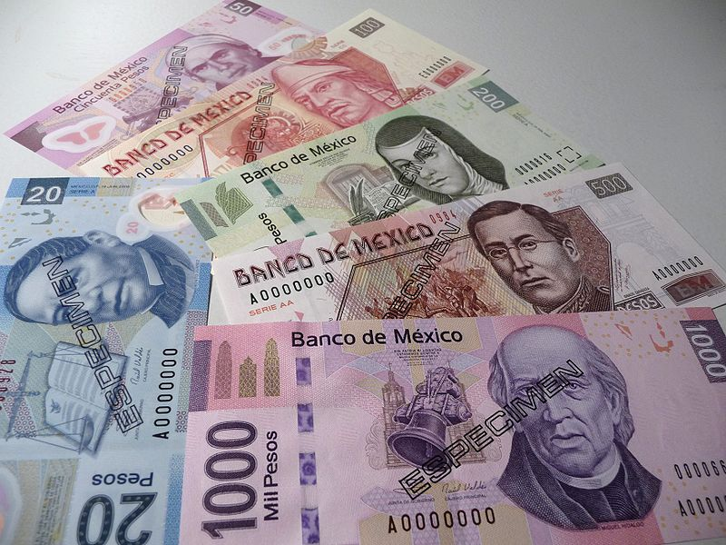
Money
In Mexico, the dinero is called Mexican pesos.
How high can you count en español?

Slide 6
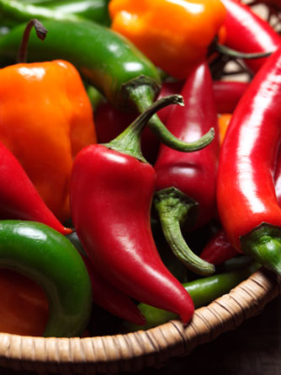
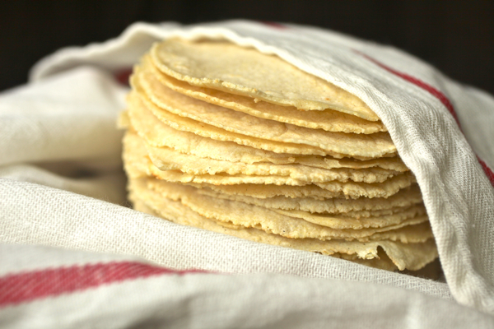
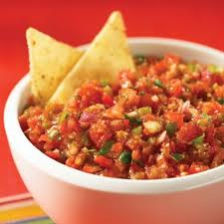
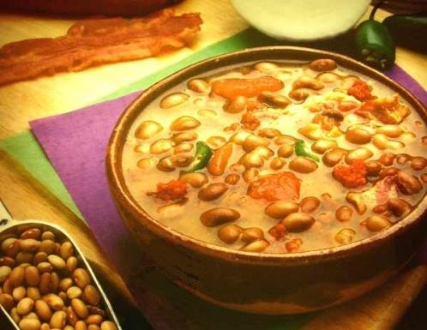
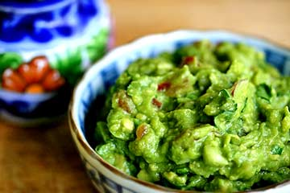
Mexican Food La comida mexicana
Spicy sauces
Corn tortillas
Rice and beans
Flautas
Tortas
Quesadillas
Mole
Click on the link to take a trip to Mexico!!!
Yum - Rico!
https://safeYouTube.net/w/r2r9

Slide 7
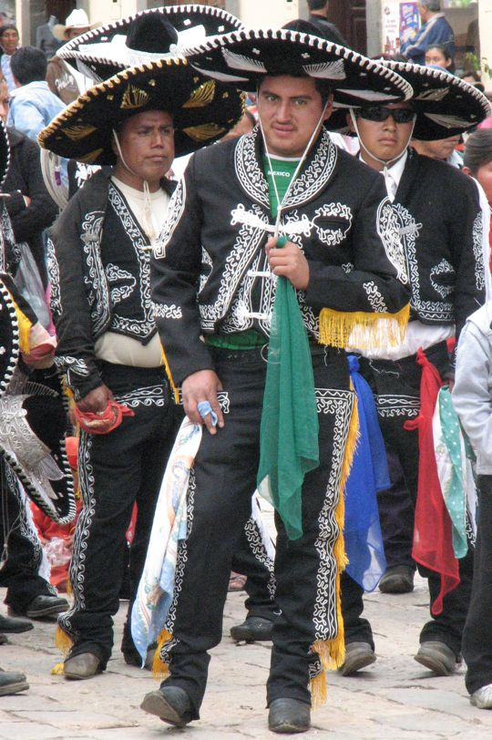
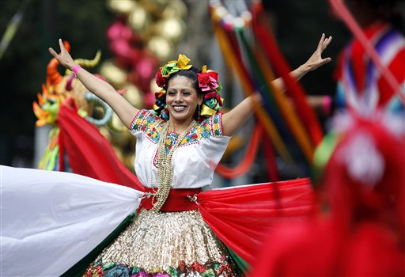
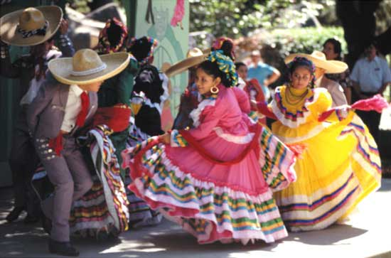
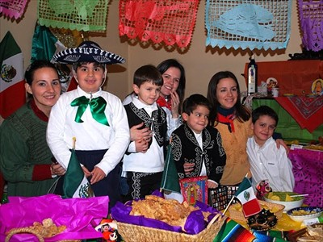
Traditional Clothing

Slide 8
AMIGOS DE FOXBOROUGH
Don’t forget to join us next Tuesday, May 5th
to continue our celebration of
CINCO DE MAYO
with Music, Dance, Art..and more…
STAY TUNED!!!

